Slide 1

Fundamentals of Computer Science and Programming
Unit 1 – Introduction

Slide 2
Outline
Course organization
Introduction to computer science & programming
History of computer science
Computational thinking
Exercise

Slide 3
Course organization

Slide 4
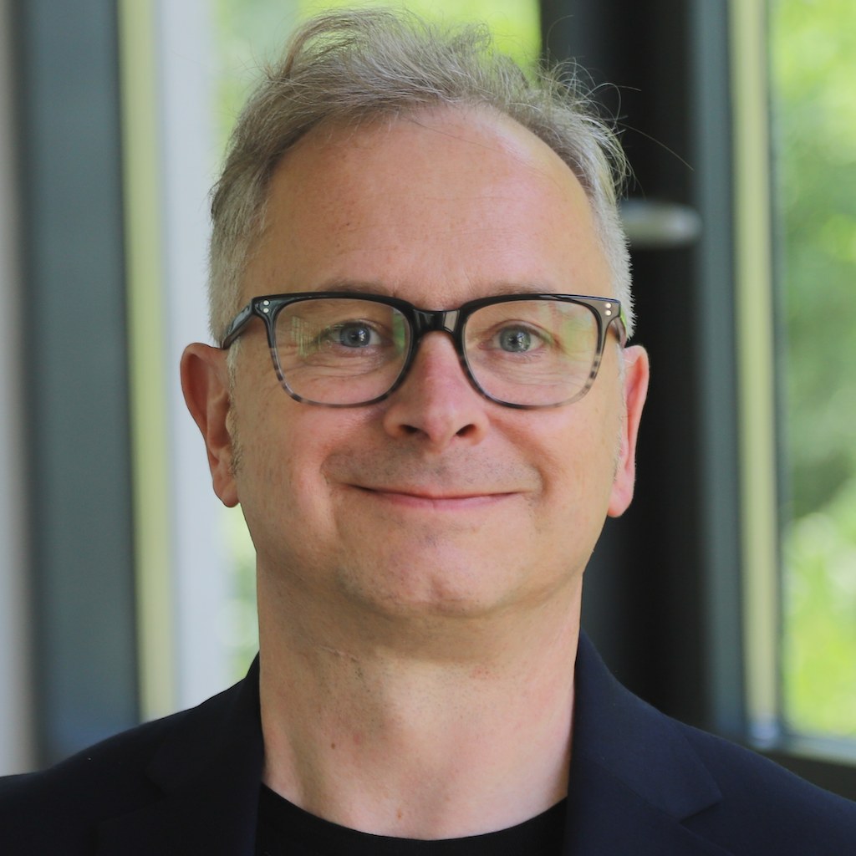
Lecturer
Name: | Prof. Dr. Ingo Frommholz
Email: | ingo.frommholz@modul.ac.at
Office Hours: | By Appointment (online)
Office: | 3.08
Name: | Libo Ren
Email: | TBA
Office Hours: | By Appointment (online)
Office: | 3.08

Slide 5
Course context
BSc Applied Data Science
Module: Fundamentals of Data Science and Engineering
Some other courses from this module:
Algorithms and Data Structures
Database Management and Design
Foundations of Artificial Intelligence
Fundamentals of Web Programming and Application Development
…
But also:
Legal Aspects of Data Science
Societal and Ethical Impacts of Data Science
...

Slide 6
Course goals
Learn about:
Basics of computer science (CS)
Boolean logic, number systems
Algorithms and complexity
Programming with Python
Procedural and Object-oriented programming
Basic data analysis including plotting
Understand:
How computations work on modern computers
Principles of algorithmic thinking
Evaluating algorithm efficiency
How to write/run/test smaller programs
Additionally:
Student goals: to pass the examination
Bonus goal for all: to have fun ☺

Slide 7
Course workload
We will have 3 academic hours every week
These are 2 hours and 15 minutes
Thursday: 15:00 – 17:30
You will earn 8 ECTS points for the course
This amounts to 8 x 25h = 200h of work
Lectures: 14 x 3h = 42h
Remaining 158h:
Homework: 14 x ~8h ≅ 112h
Preparation for the exam: 46h

Slide 8
Grading
Homework:
Mathematical examples
Programming exercises
Final exam:
You will need to answer questions and solve smaller problems
In-class participation:
We will start by students presenting their homework
We will have smaller exercises and problems to solve during class
Asking questions, discussing

Slide 9
Grading
Final exam: 33%
Homework: 34%
In-class participation: 33%
% | Grade
90 - 100 | 1 (Excellent)
80 - 89 | 2 (Good)
70 - 79 | 3 (Average)
60 - 69 | 4 (Sufficient)
< 60 | 5 (Fail)

Slide 10
Academic Misconduct
There will be zero tolerance to any form of academic misconduct
Fraud
Cheating
Plagiarism
Fabrication of material or data → AI!
Plagiarism includes:
Plagiarism of text
Plagiarism of source code
You can discuss the homework with other students
But each student has to submit their own work and only their work!
More information in regulations
Zero tolerance: Zero points → Negative grade

Slide 11
Course schedule
Unit | Topic | Homework
1 | Introduction, History, Computational Thinking | Math.
2 | Propositional Logic and Boolean Algebra | Math.
3 | Number Systems | Math.
4 | Programming Basics with Python I | Prog.
5 | Programming Basics with Python II | Prog.
6 | Programming Basics with Python III | Prog.
7 | Programming Basics with Python IV | Prog.
The deadline for the homework is always at the beginning of the next lecture!

Slide 12
Course schedule
Unit | Topic | Homework
8 | Programming Basics with Python V | Prog.
9 | Algorithms | Math./Prog.
10 | Introduction to algorithmic complexity | Math./Prog.
11 | Searching and Sorting | Prog.
12 | Object-oriented Programming with Python | Prog.
13 | Introduction to Data Science | Prog.
14 | Final examination | Prog.
The deadline for the homework is always at the beginning of the next lecture!

Slide 13
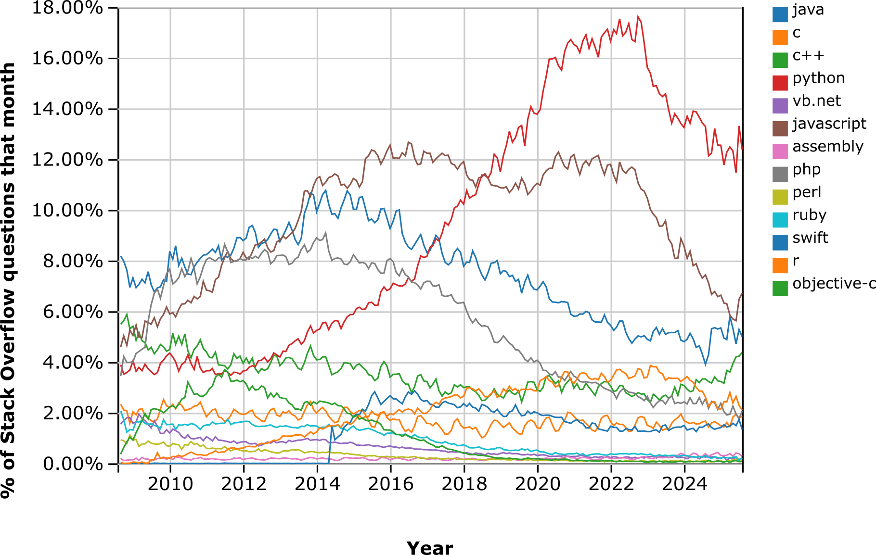
Programming with Python
Source: Stack Overflow Trends

Slide 14
Course logistics
Announcements: On Moodle
Forum: On Moodle
Slides
Python notebooks
Literature:
Allen Downey, Think Python 3rd Edition
https://allendowney.github.io/ThinkPython/
Robert Sedgewick, Introduction to Programming in Python
https://introcs.cs.princeton.edu/python/home/
John Guttag, Introduction to Computation and Programming using Python

Slide 15
Question policy
Interrupt me immediately ☺ and ask any question
Ask after the lecture
Make an appointment for office hours
Moodle forum and MS Teams group chat:
Check for similar questions
Post a question
Write an email
Write an MS Teams message

Slide 16
Introduction to computer science & programming

Slide 17

Why should I learn to program?
Let us watch Christian Genco’s TED Talk
Source: Southpark

Slide 18
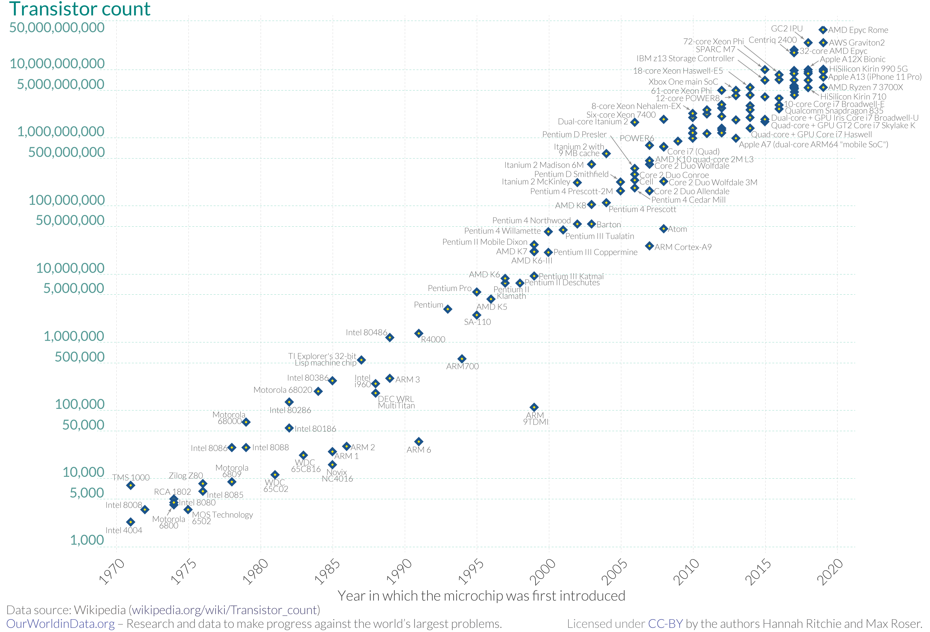
Why should I learn to program?
Source: Our World in Data

Slide 19
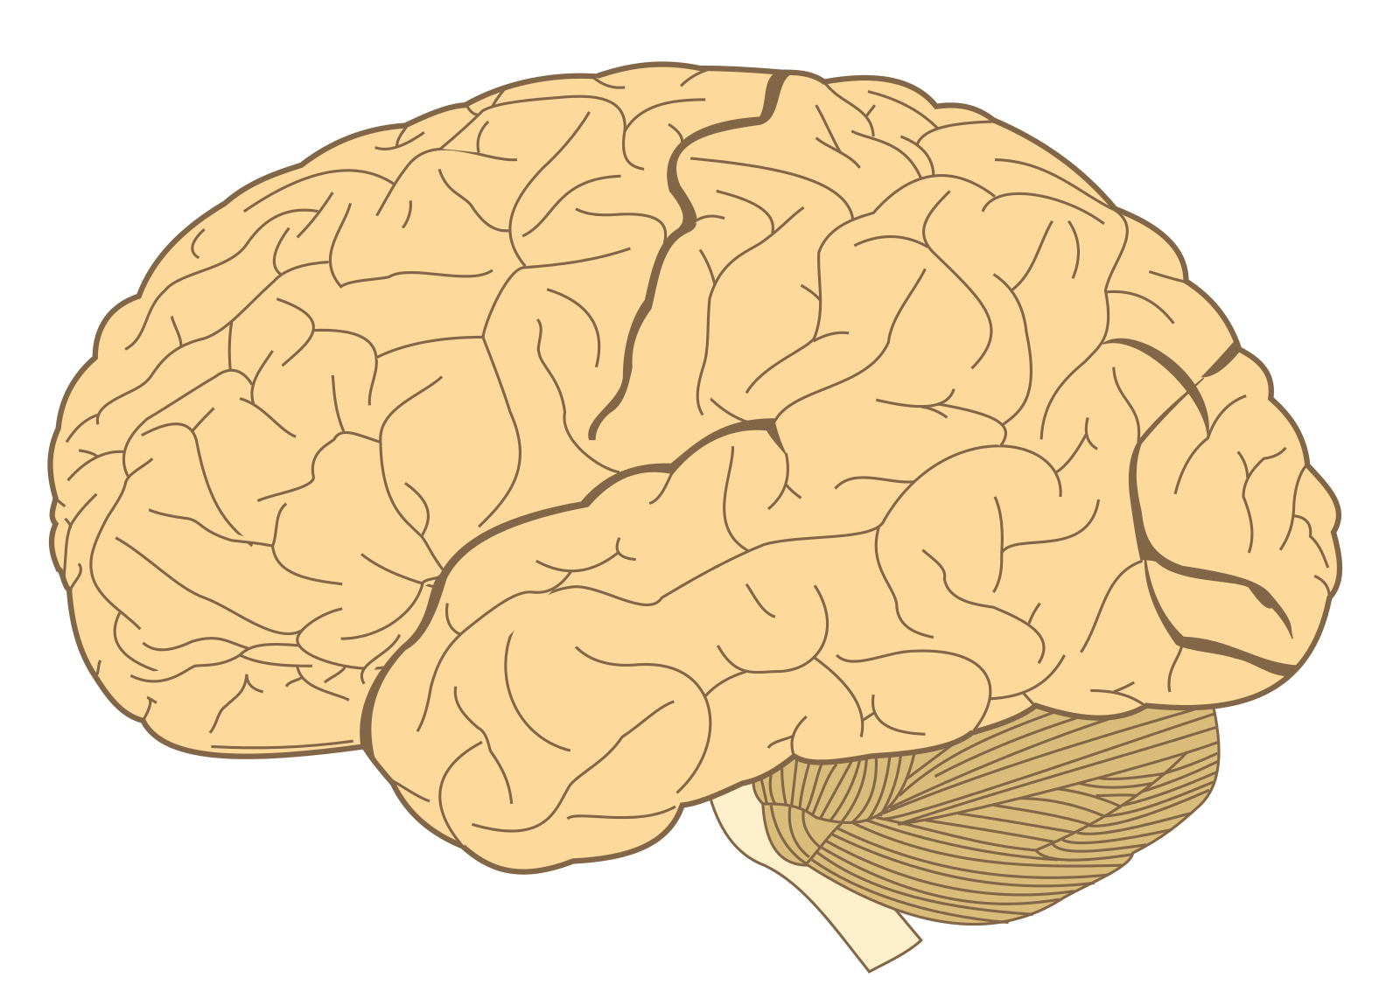
Why should I learn to program?
Neurons count
≅ 86,000,000,000
Source: Our World in Data

Slide 20
Why should I learn to program?
Neurons count
≅ 86,000,000,000
Source: Our World in Data

Slide 21
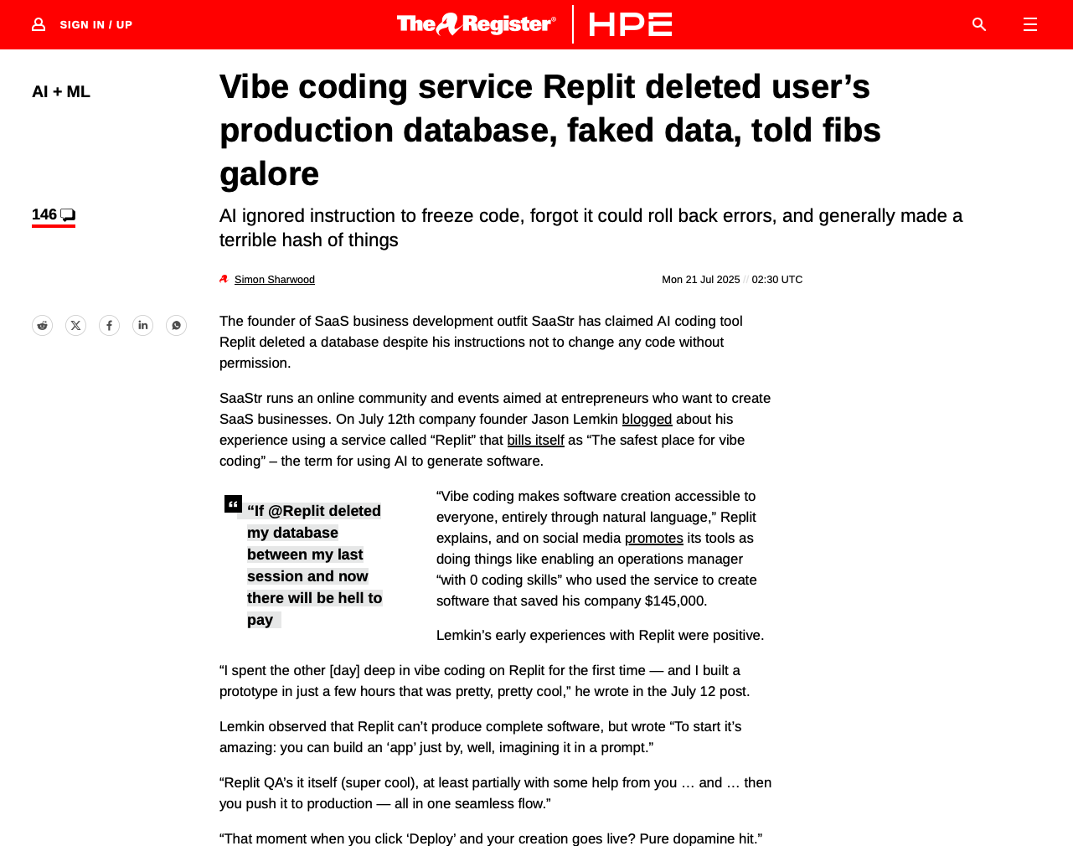
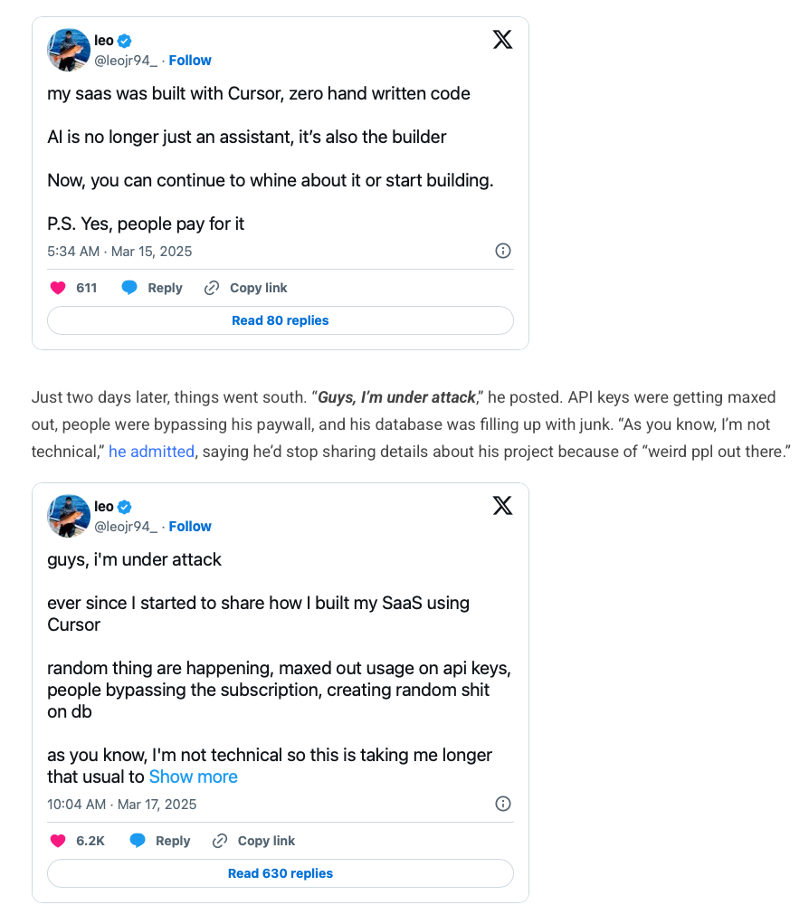
AI & Vibe Coding
Prompt an LLM to write your code
Can it replace programming skills? NO!
Especially risky for beginners, who don’t know what the AI does behind the scene
Using AI might be convenient, but without programming and expert knowledge, you are doomed to fail! 💀
Issues regarding
Security
Stability
Scalability
Hidden bugs
https://www.theregister.com/2025/07/21/replit_saastr_vibe_coding_incident/
https://techstartups.com/2025/03/26/when-vibe-coding-goes-wrong/

Slide 22
What is computer science?
Science of automatic information processing
In German: Informatik = Information + Automatik
Computer science is more than just “computer” science
It covers the automatic information processing in:
Nature
Technology
Society
Same as astronomy is not just about telescopes (Edsger W. Dijkstra)

Slide 23
Computer science is ….
Science of …
Information
Systems
Transformation
Engineering
Practice

Slide 24
Computer science is ….
Science of …
Information
Systems
Structure,
Behavior,
Interaction
Transformation
Processing,
Storing,
Communication
Engineering
Practice

Slide 25
Computer science is ….
Science of …
Natural (cognitive)
Information
Systems
Social
Structure,
Behavior,
Interaction
Transformation
Processing,
Storing,
Communication
Artefacts
Engineering
Practice

Slide 26
Computer science is ….
Science of …
Natural (cognitive)
Information
Systems
Social
Structure,
Behavior,
Interaction
Transformation
Processing,
Storing,
Communication
Artefacts
Engineering
Practice

Slide 27
Computer science is ….
Neural Networks / AI
Science of …
Natural (cognitive)
Brain Computer Interfaces
Information
Systems
Social
Structure,
Behavior,
Interaction
Transformation
New Media
Processing,
Storing,
Communication
Artefacts
Engineering
Data Science
Practice
Geom. Algorithms
Digital Libraries
Visual Analytics
Simulation & Analysis
VR
Visual Computing
IT Security

Slide 28
CS is ….
Quantum Computing
Neuro CS
Comp. Neuroscience
Bio-CS
Mashine Lerning
BCI
Nano-Computing
Science of …
Natural (cognitive)
Arts
Usability
Information
Systems
Social
Social Sciences
Structure,
Behavior,
Interaction
Architecture
Dig. Libraries
New Media
Transformation
Business
Pedagogy
Processing,
Storing,
Communication
eLearning
Artefacts
Knowledge Management
Engineering
Government
Practice
Visual Computing
Geom. Algorithms
Sports
Law
Robotics
Computer Graphics
Verification & Validation
Movies
Distributed Computing
IT Security
Astronomy
„Applications“
Games
Interactive Systems
Engineering
Geo-Sciences
Software Engineering
Medicine
Statistics
„Interdisciplinary CS“
Entertainment

Slide 29
History of computer science

Slide 30
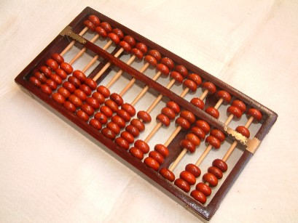
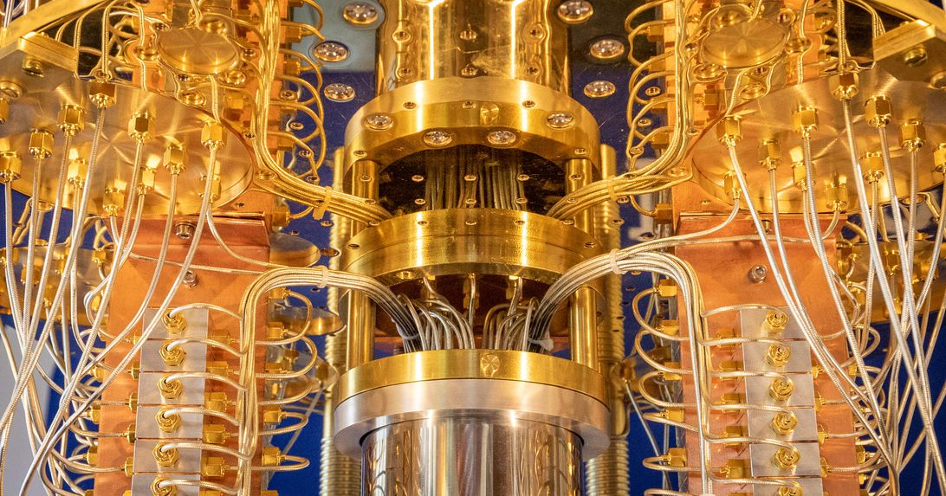
CS and other science and engineering disciplines
Computer science is related to those three disciplines:
Mathematics
Mechanics
Electronics
… or from the Abacus to the quantum computer
Sources: wikipedia.org, cnet.com

Slide 31
Mathematics and Computer Science
Various milestones between 30.000 BC and 200 AD
Abacus (200 AD)
Foundation of the decimal system (500 AD)
Arabic numerals in Europe (1200 AD)
Adam Riese (1500 AD) published computing-laws for decimal system

Slide 32
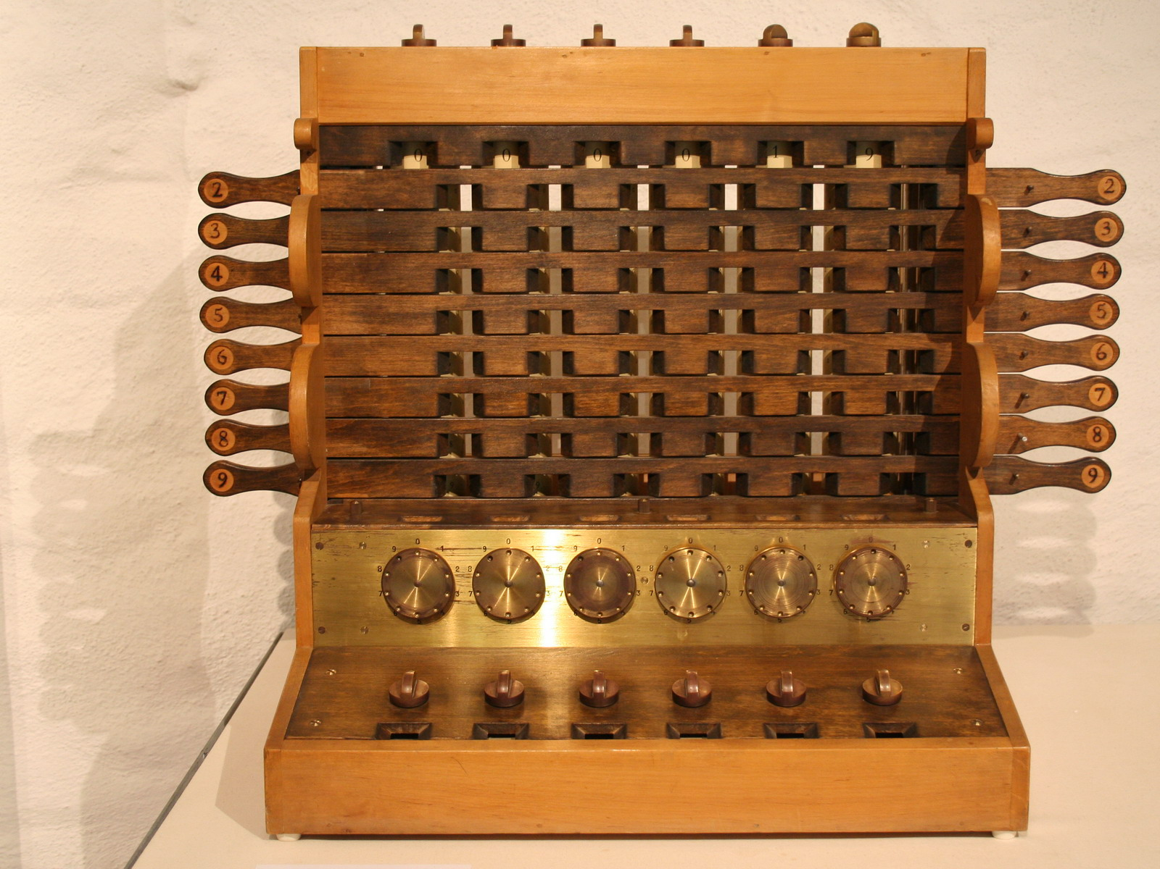
Mathematics, mechanics & computer science
First calculator by Wilhelm Schickard (1623)
Based on cogs
Supported addition, subtraction, multiplication and division
Acoustic signal when buffer overflow
Source: wikipedia.org

Slide 33
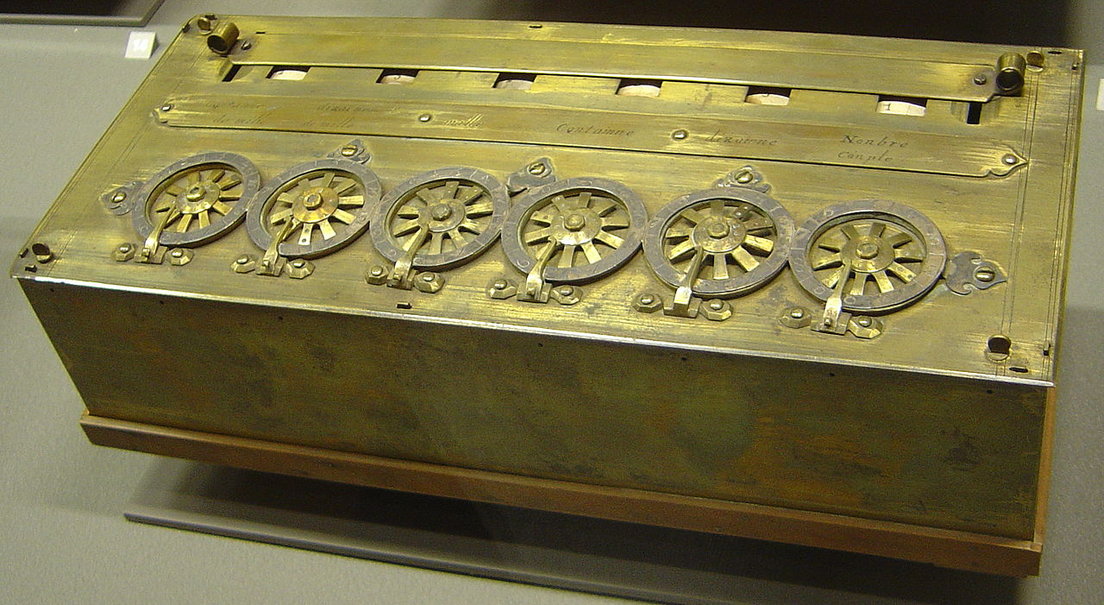
Mathematics, mechanics & computer science
Blaise Pascal & Wilhelm Schickard
First (mechanical) hand calculator
50 prototypes
Public presentation 1645
Functionality: Addition and subtraction of two numbers
Source: wikipedia.org

Slide 34
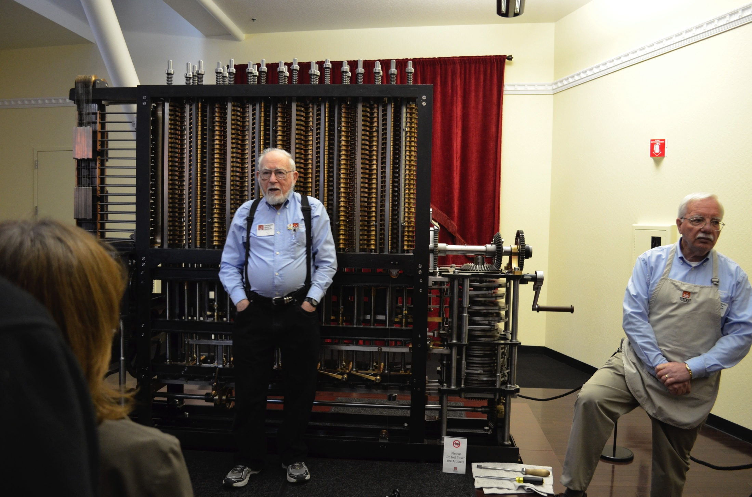
Mathematics, mechanics & computer science
Charles Babbage (1791 - 1871)
Mathematician, philosopher, inventor and developer
“One of the fathers of (mechanical) computers”
Known for the Babbage- or Difference-Engine for solving polynomial equations
Uses the method of divided difference to compute polynomials
Polynomials then can be used to approximate other functions, e.g., logarithm
Source: Computer History Museum, Mountain View, USA

Slide 35
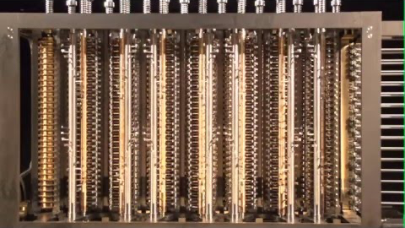
Mathematics, mechanics & computer science
Source: https://www.youtube.com/embed/be1EM3gQkAY

Slide 36
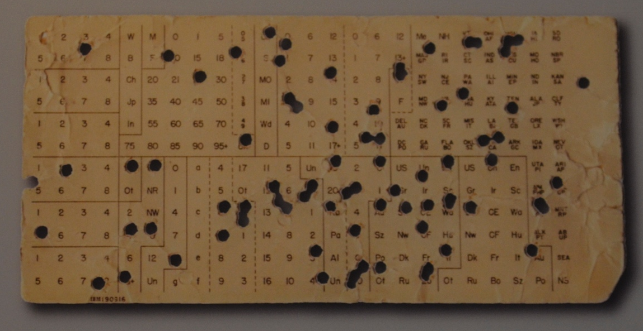
Mathematics, mechanics & computer science
Hermann Hollerith (1860 - 1929)
Invented the punch card system to store data
Automatic evaluation of the stored data through punch card readers
Laid the groundwork for the storage of first computer instructions
Electromechanical principles
“An Electric Tabulating System” is his PhD Thesis at Columbia
Source: Computer History Museum, Mountain View, USA

Slide 37
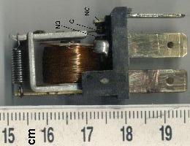
Relays
Mechanical switch
Problems:
Switching needed several fractions of a second
Needed a lot of space
Clock speed very limited
Mechanical deterioration
Source: wikipedia.org

Slide 38
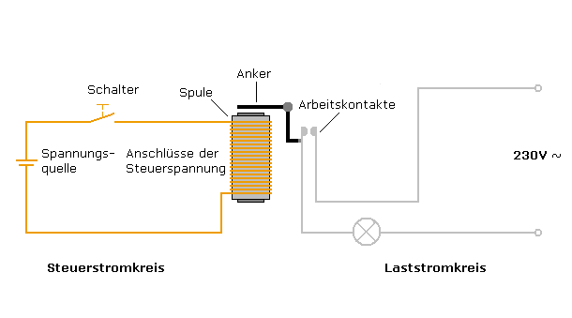
Relays
Mechanical switch
Coil is charged up
Magnetic field pulls down anchor
Operating contacts are closed
Current flows
Switch
Operating contacts
Coil
Source: wikimedia.org

Slide 39
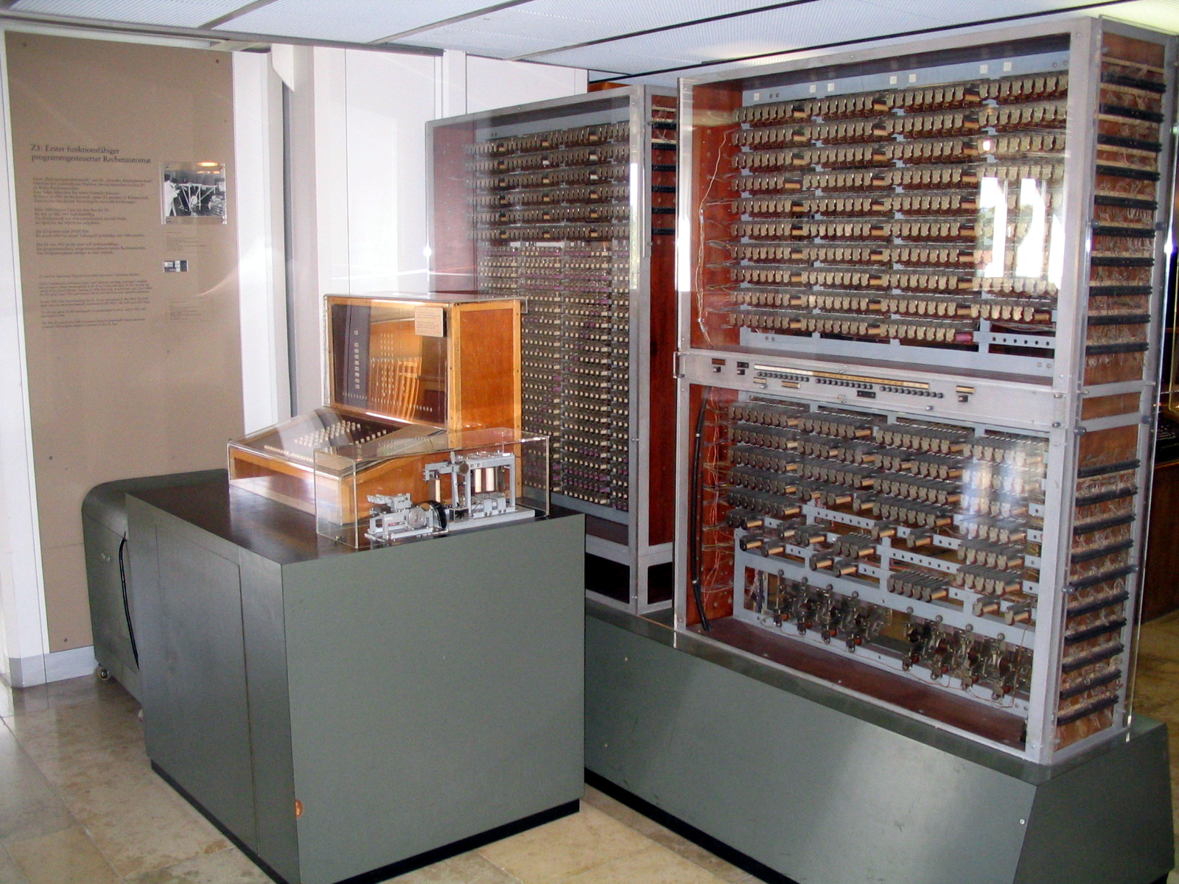
First programmable digital computer
Konrad Zuse (1910 - 1995)
Developed the first programmable digital computer worldwide - the Z3.
600 relays for the processor
1600 relays for the memory
Based on binary floating point arithmetic
Size of a (very big) wardrobe
15-20 arithmetic operations / sec.
Further information about K. Zuse:
http://zuse.zib.de
Source: wikipedia.org

Slide 40
Vacuum tubes
Vacuum tubes are also switches
1000 times faster than a relay
Smaller than a relay
Problems:
Needs a lot of power
Low durability

Slide 41
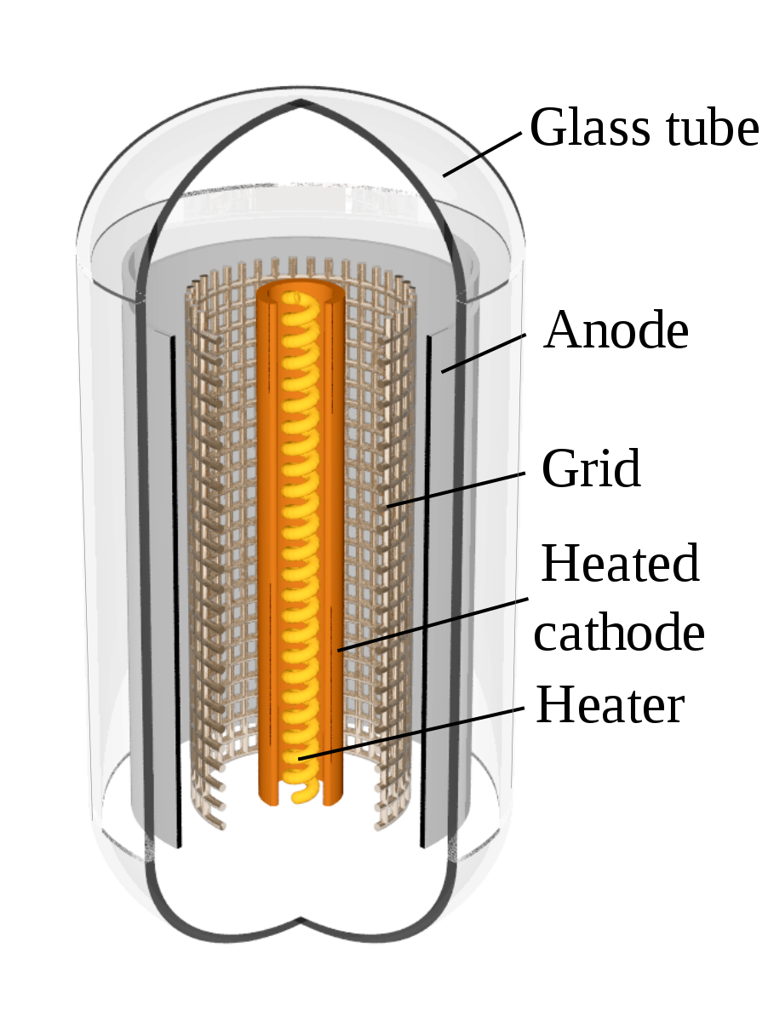
Vacuum tubes
Current-carrying cathode
Current-absorbing anode
If the grid is positively charged up (w.r.t. cathode) :
Electrons flow from cathode to anode
If the grid is negatively charged up (w.r.t. cathode) :
Electrons are pushed off and stops current flow
Source: wikipedia.org

Slide 42
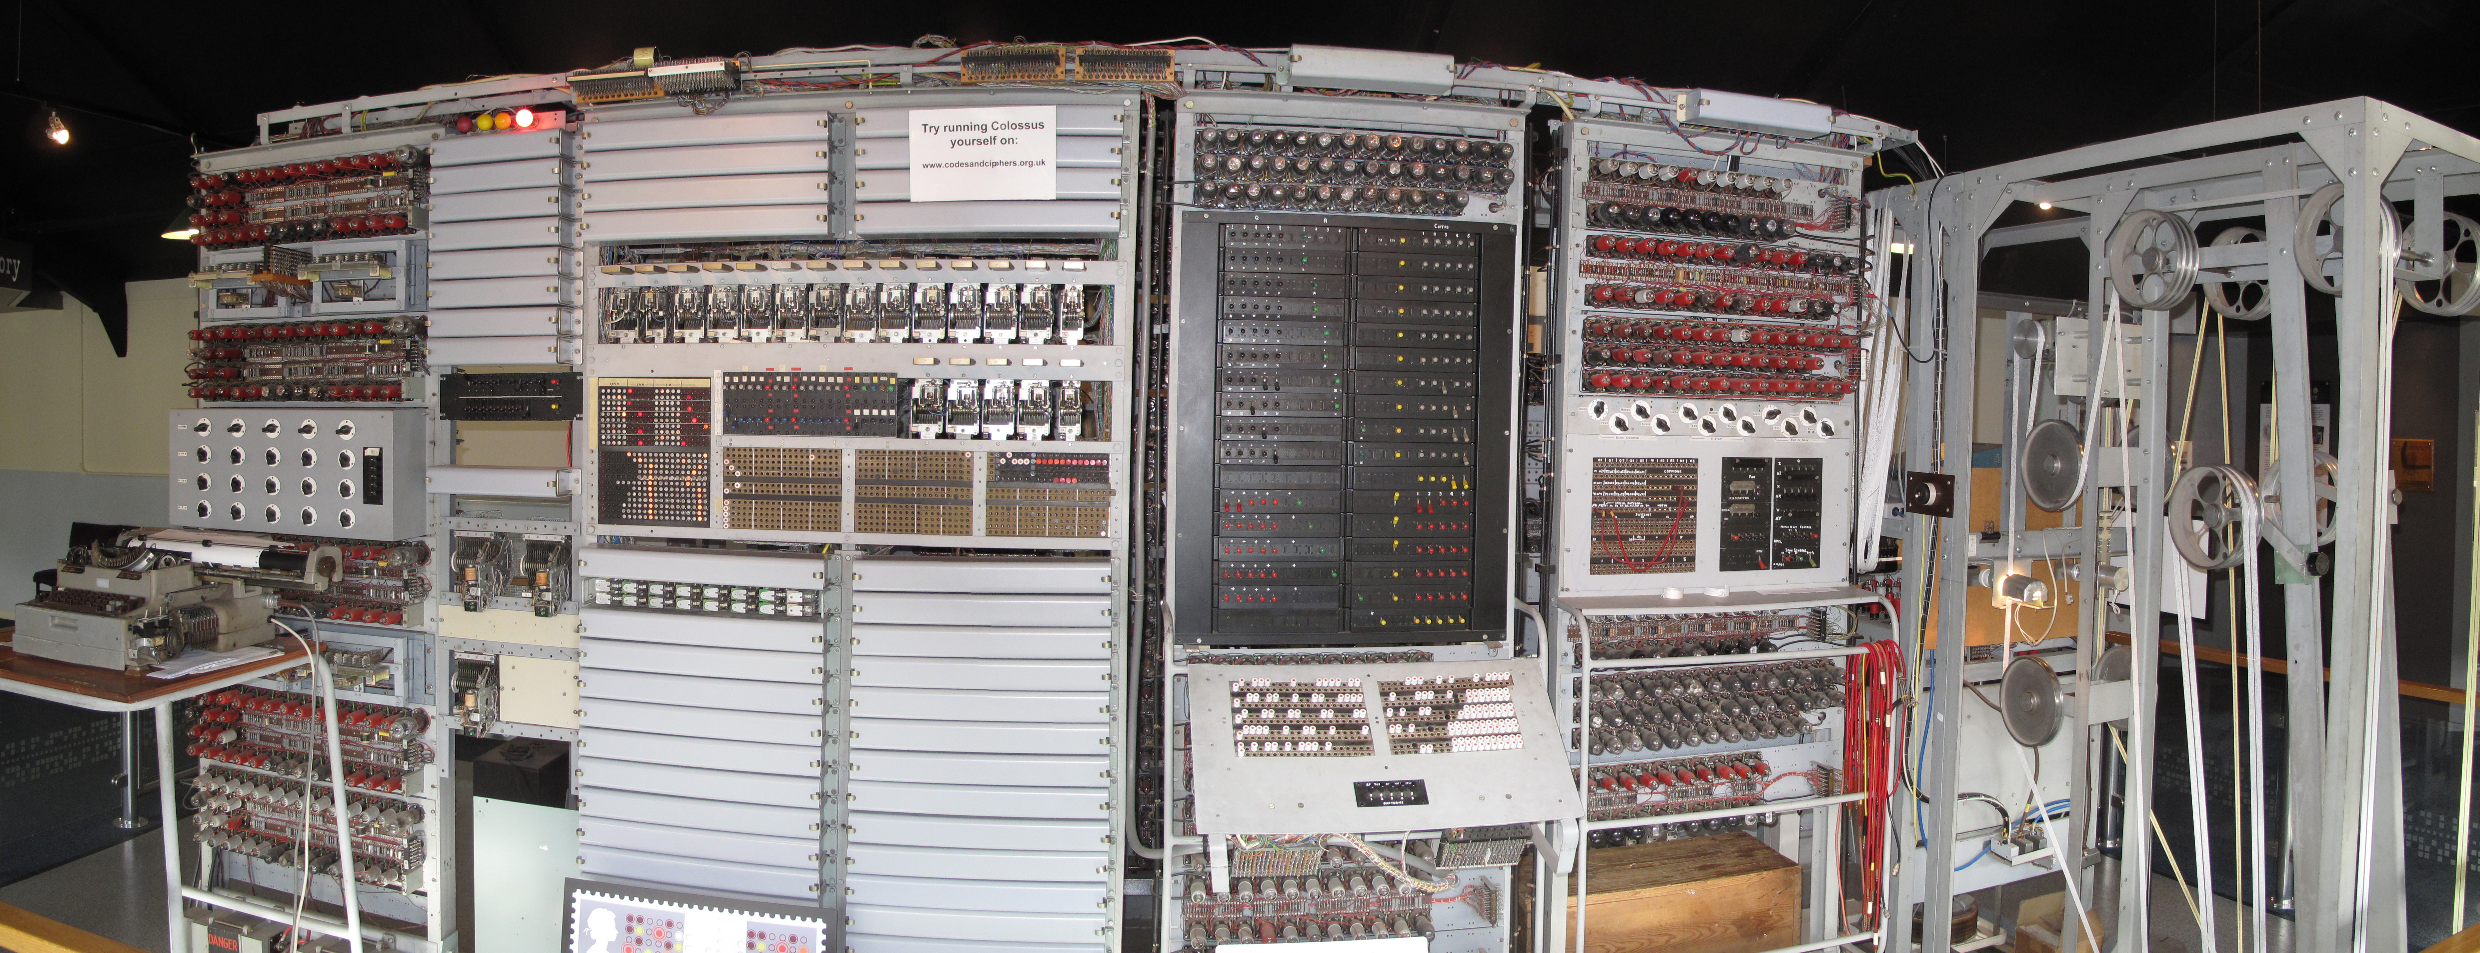
COLOSSUS
First programmable electronic digital computer
Designed by Tommy Flowers; used around 1,600 vacuum tubes
Presented in 1944 at Bletchley Park, England (“Home of the codebreakers”) -- Alan Turing had his office there
Build for codebreaking the German Lorenz cipher (specialised, not general purpose)
Front view of the Colossus reconstruction showing, from right to left: (1) The "bedstead" containing the message tape in its continuous loop and with a second one loaded. (2) The J-rack containing the Selection Panel and Plug Panel. (3) The K-rack with the large "Q" switch panel and sloping patch panel. (4) The double S-rack containing the control panel and, above the image of a postage stamp, five two-line counter displays. (5) The electric typewriter in front of the five sets of four "set total" decade switches in the C-rack.
By TedColes - Own work, CC BY-SA 4.0, https://commons.wikimedia.org/w/index.php?curid=38648141

Slide 43
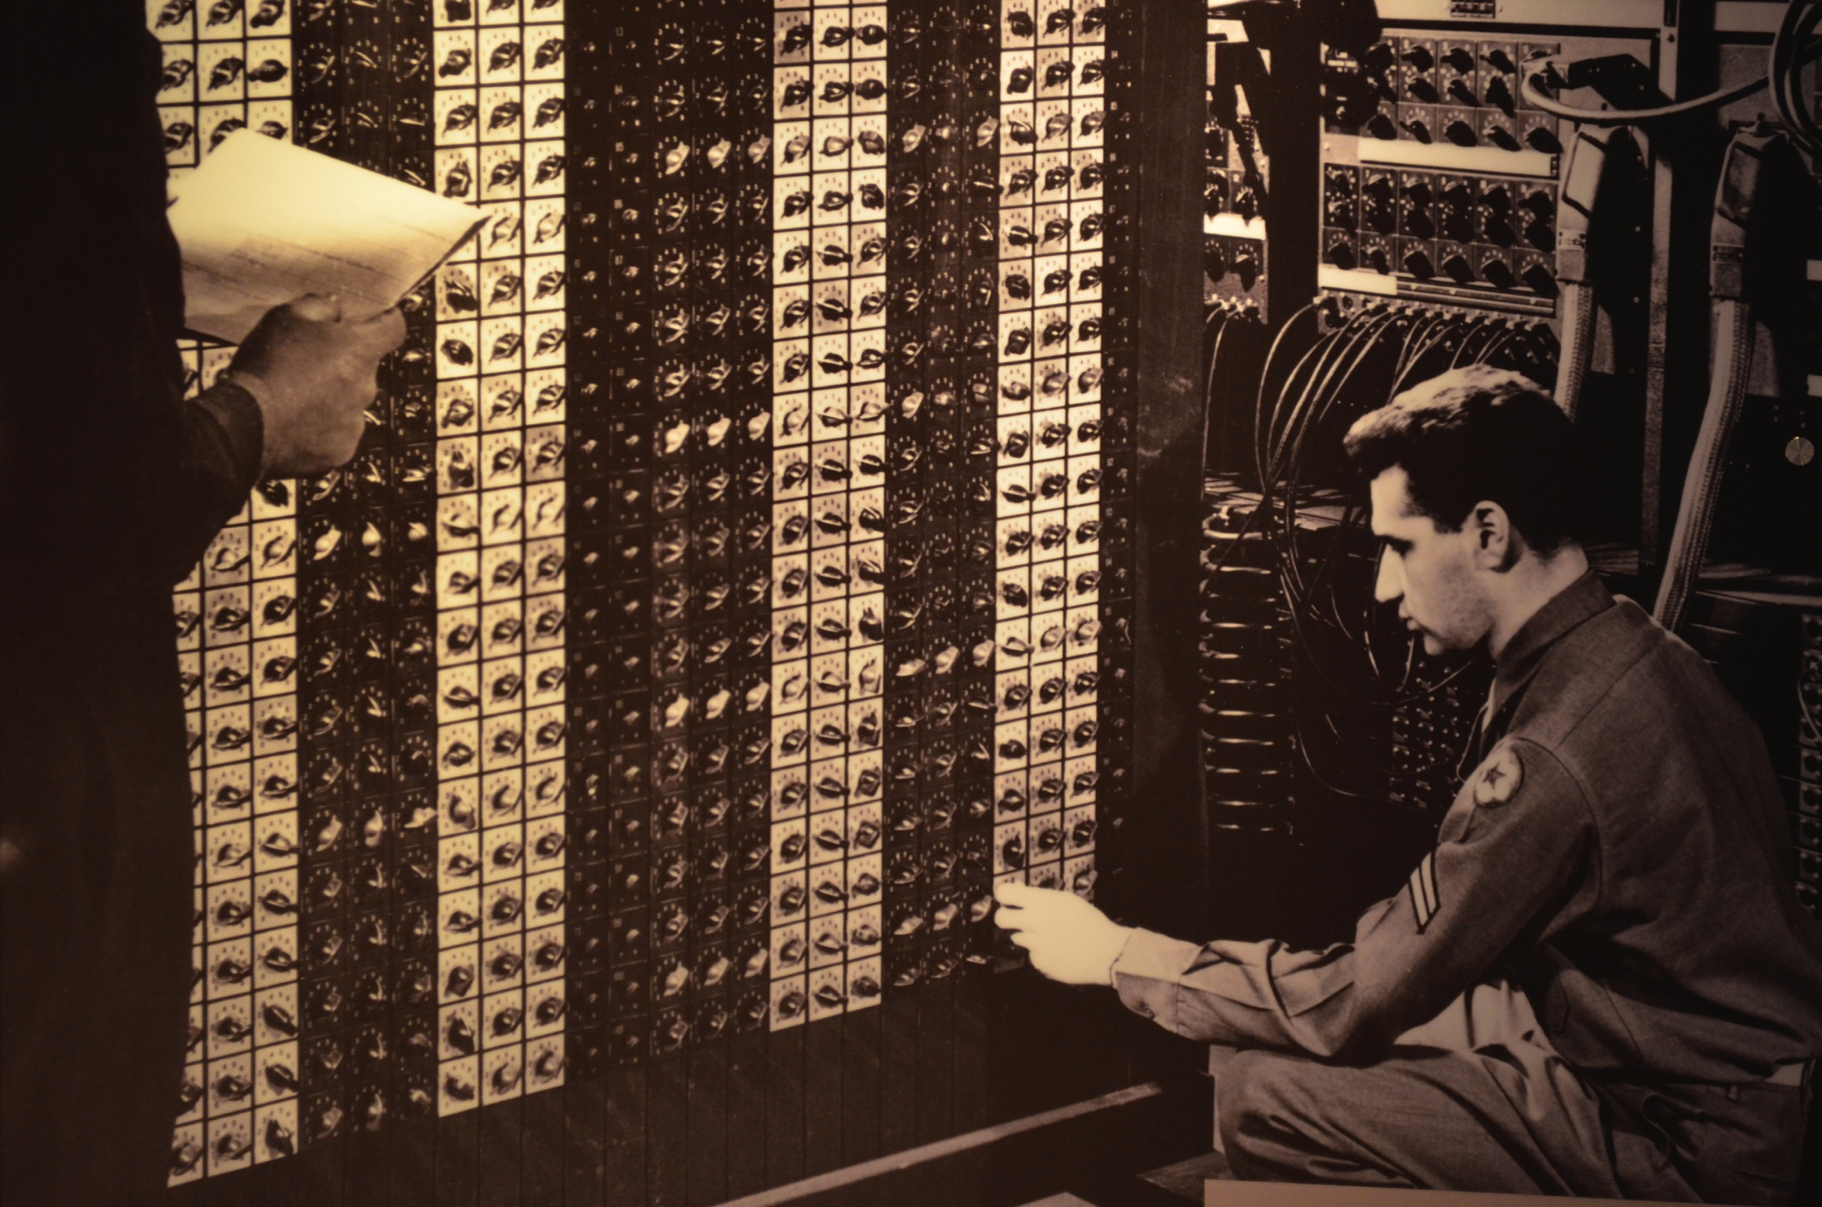
ENIAC
Electronic Numerical Integrator and Computer
First general-purpose programmable electronic computer
Presented in 1946
Vacuum tubes used to store numbers electronically
17,468 vacuum tubes
140 m²
27 metric tons
174 kW
Modern computers: 60-250 W
Source: Computer History Museum, Mountain View, USA

Slide 44
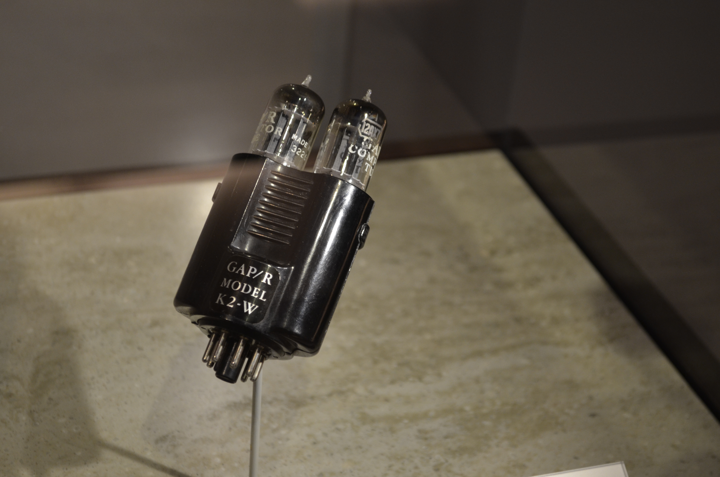
Durability of vacuum tubes
Vacuum tubes had to be replaced about every other day
Took 15 minutes to find the faulty vacuum tube
Source: Computer History Museum, Mountain View, USA

Slide 45
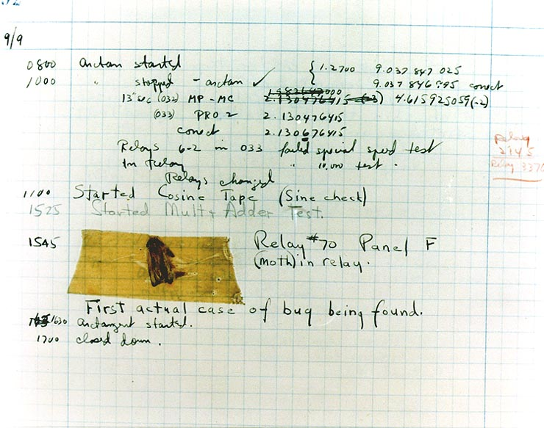
First Bug
The term “bug” for an error in the execution of a program goes back to a computer pioneer called Grace Hopper (1906 - 1992).
On 9th September 1947 she found a moth in one of the relays of the computer Mark II Aiken Relay Calculator and documented it with the words: “First actual case of bug being found”.
This was the first case of “debugging” ☺.
Source: wikipedia.org

Slide 46
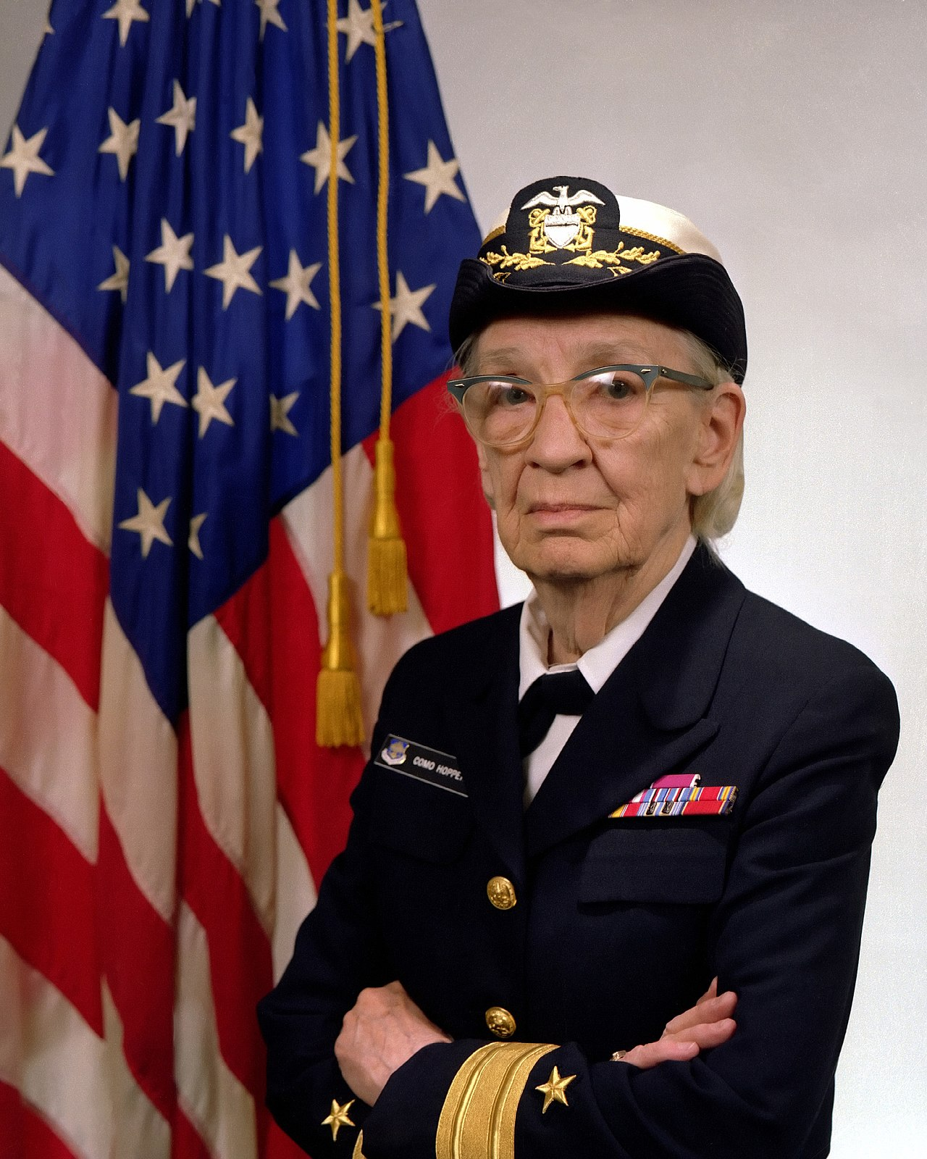
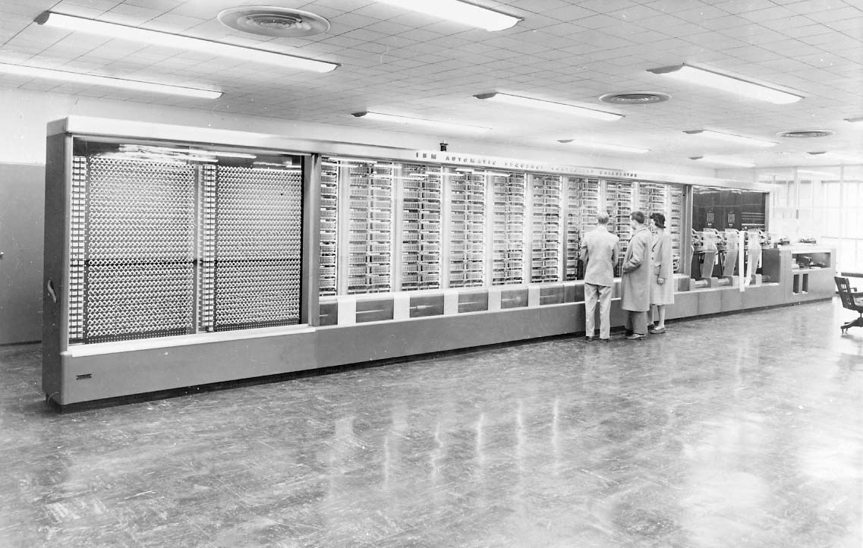
Grace Hopper (Harvard Mark I)
Grace Hopper aka. “Queen of Software”.
Programming should be simplified with
an English-based language
Harvard Mark I
Sources: wikipedia.org, britannica.com

Slide 47
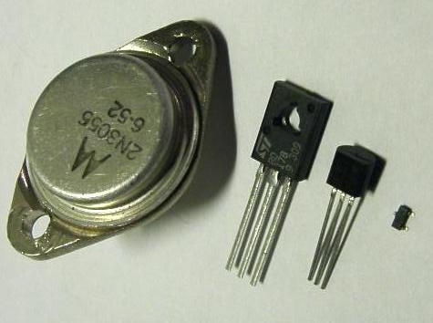
Transistors
Shockley, Bardeen and Brattain introduce the first transistor in 1947
They got the Nobel prize in 1956 for this invention
Composed of semiconductor material (solid material)
Most of them are made of silicon
Compared to vacuum tube, transistors are:
Smaller
Require less power
More durable
Source: wikipedia.org

Slide 48
Computer architecture
Johann von Neumann invents the “Von Neumann Architecture”.
Program and data is stored in the main memory
Processing power until 1960:
1-2 KByte memory
0.02 MIPS
Processing power from 1986 until today:
8 MByte – 32 Gbyte
> 100 MIPS

Slide 49
Von Neumann Architecture
CPU
Arithmetic / Logic Unit
Control Unit
Bus system
Input / Output device
Memory unit

Slide 50
Transistor count
Source: Our World in Data

Slide 51
Computational thinking
Slides in this section are based on Chapters 1 and 3 of
Introduction to Computation and Programming using Python
by John Guttag

Slide 52
Getting started
Computer does two things only
Performs calculations ≅ 1000 MIPS
Stores the results of these calculations ≅ TBs of data
For most of the history computations were limited
Speed of calculation of the human brain
Ability to record computation results
Only smallest problems were solved computationally
Even with the speed and storage of modern computers
There are still models which are not tractable computationally
For example, climate change
But, more and more problems can be solved computationally
This requires computational thinking
What do we mean by computational thinking?

Slide 53
Declarative vs. imperative knowledge
All knowledge is either declarative or imperative
Declarative knowledge is composed of statements of facts
Example 1: The square root of x is a number y such that y ⋅ y = x.
This is a statement of fact. It does not tell us anything on how to find the square root of x.
Imperative knowledge is „how to“ knowledge for computations
Imperative knowledge is the basis of computational thinking
Remark 1: Declarative knowledge is still extremely useful and important in computer science. In fact, it represents one of the mathematical fundamentals of computer science. We will discuss this in the next two lectures.

Slide 54
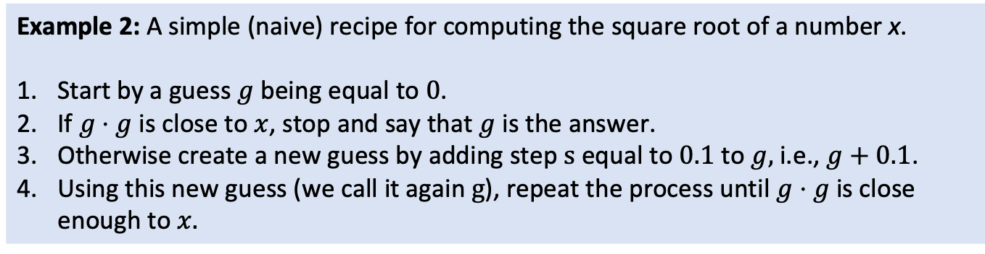
Exhaustive Enumeration Square Root (EESR)
„How to“ (recipe) compute the square root of a number
Example 2: A simple (naive) recipe for computing the square root of a number x.
Start by a guess $g$ being equal to 0.
If $g⋅g$ is close to $x$, stop and say that $g$ is the answer.
Otherwise create a new guess by adding step s equal to 0.1 to $g$, i.e., $g+0.1$.
Using this new guess (we call it again g), repeat the process until $g⋅g$ is close enough to $x$.

Slide 55
Algorithm
Description of the method:
Sequence of simple steps
Flow of control that specifies when each step is executed
Such a description is called an algorithm
Definition 1: An algorithm is a finite list of instructions that describe a computation that when executed on a provided set of inputs will proceed through a set of well-defined states and eventually produce an output.

Slide 56
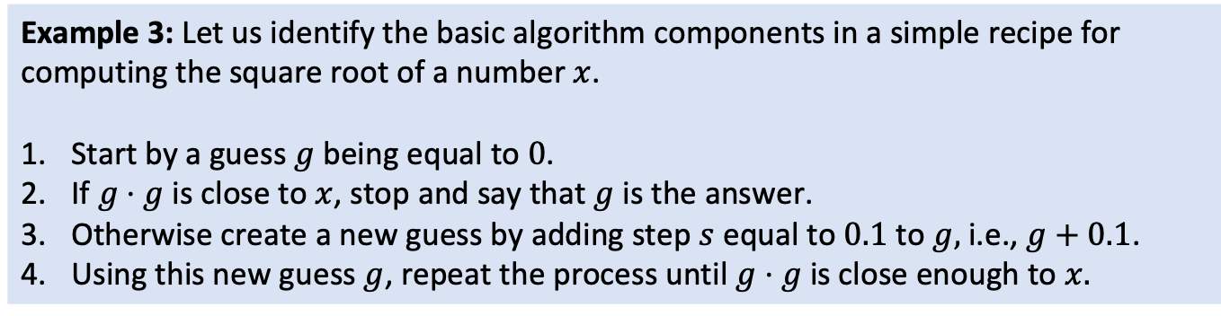
Square root algorithm
Finite list of instructions describing a computation
State
Input
Example 3: Let us identify the basic algorithm components in a simple recipe for computing the square root of a number $x$.
Start by a guess $g$ being equal to 0.
If $g⋅g$is close to $x$, stop and say that $g$ is the answer.
Otherwise create a new guess by adding step $s$ equal to 0.1 to $g$, i.e., $g+0.1$.
Using this new guess $g$, repeat the process until $g⋅g$is close enough to $x$.
Instruction
Output
State
State
Instruction
State
Instruction
Instruction
Definition 1: An algorithm is a finite list of instructions that describe a computation that when executed on a provided set of inputs will proceed through a set of well-defined states and eventually produce an output.
Remark 2: This algorithmic technique is called guess and check. In fact, it is a special variant of guess and check called exhaustive enumeration. We enumerate all possibilities until we get the right answer or exhaust the space of possibilities.

Slide 57
Algorithm as a recipe
Example 4: An algorithm is a bit like a recipe from a cookbook.
Put custard mixture over heat.
Stir.
Dip spoon in custard.
Remove spoon and run finger across back of spoon.
If clear path is left, remove custard from heat and let cool.
Otherwise repeat.

Slide 58
Exercise

Slide 59
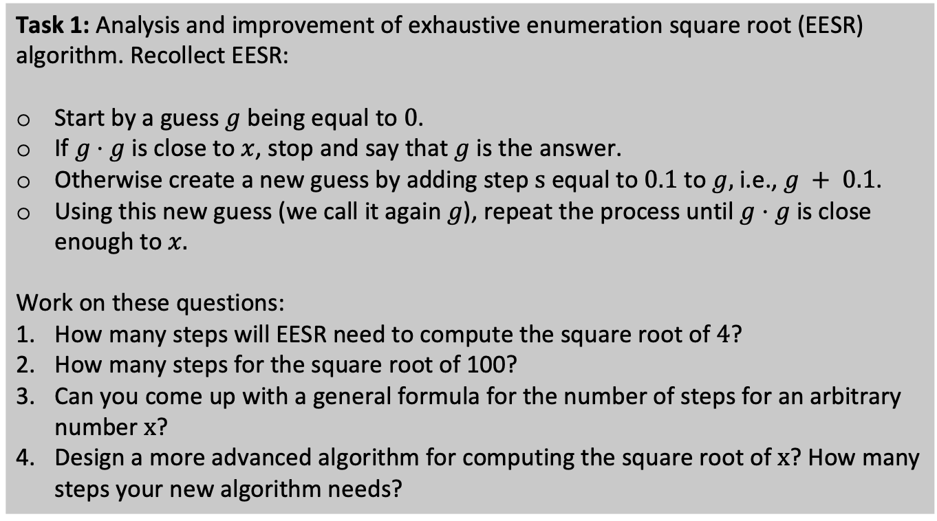
Student task
Task 1: Analysis and improvement of exhaustive enumeration square root (EESR) algorithm. Recollect EESR:
Start by a guess $g$ being equal to 0.
If $g⋅g$is close to $x$, stop and say that $g$ is the answer.
Otherwise create a new guess by adding step s equal to 0.1 to $g$, i.e., $g + 0.1$.
Using this new guess (we call it again $g$), repeat the process until $g⋅g$is close enough to $x$.
Work on these questions:
How many steps will EESR need to compute the square root of 4?
How many steps for the square root of 100?
Can you come up with a general formula for the number of steps for an arbitrary number x?
Design a more advanced algorithm for computing the square root of x? How many steps your new algorithm needs?

